Slide 1


Slide 2
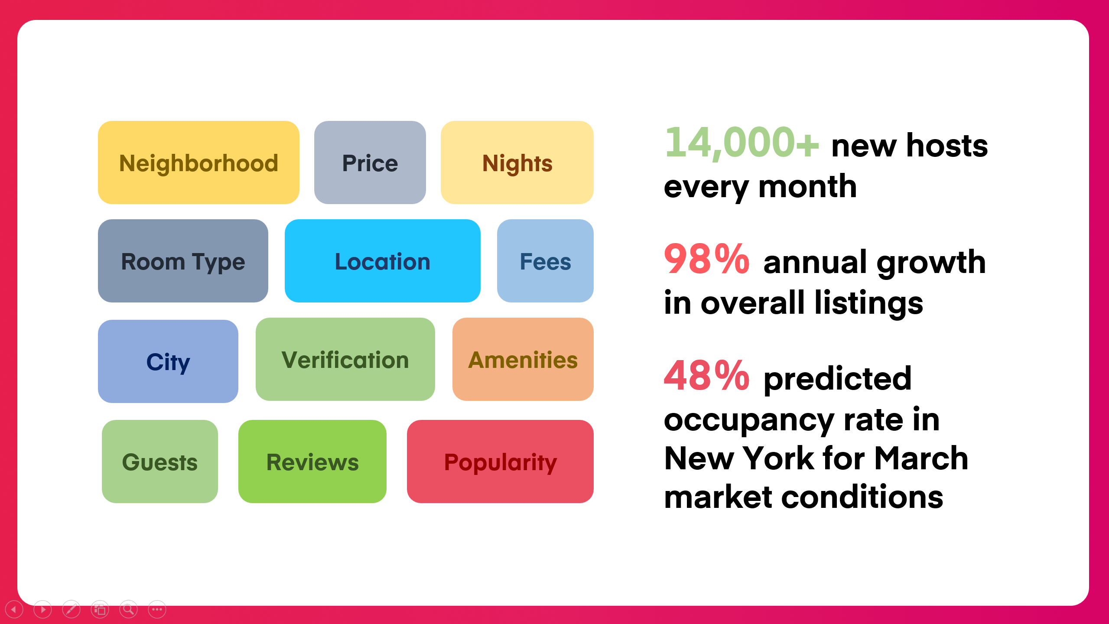

Slide 3


Slide 4
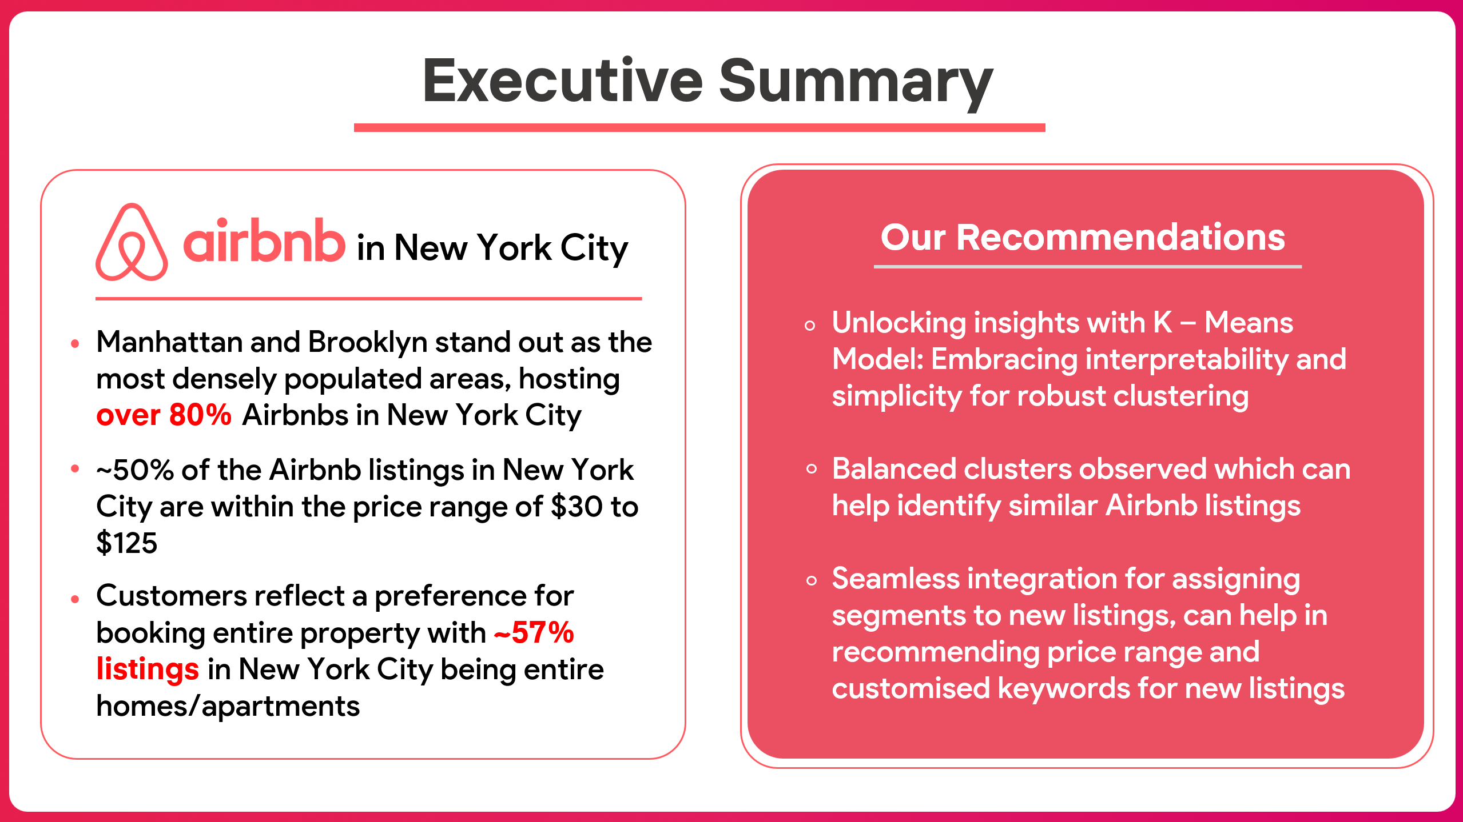

Slide 5


Slide 6
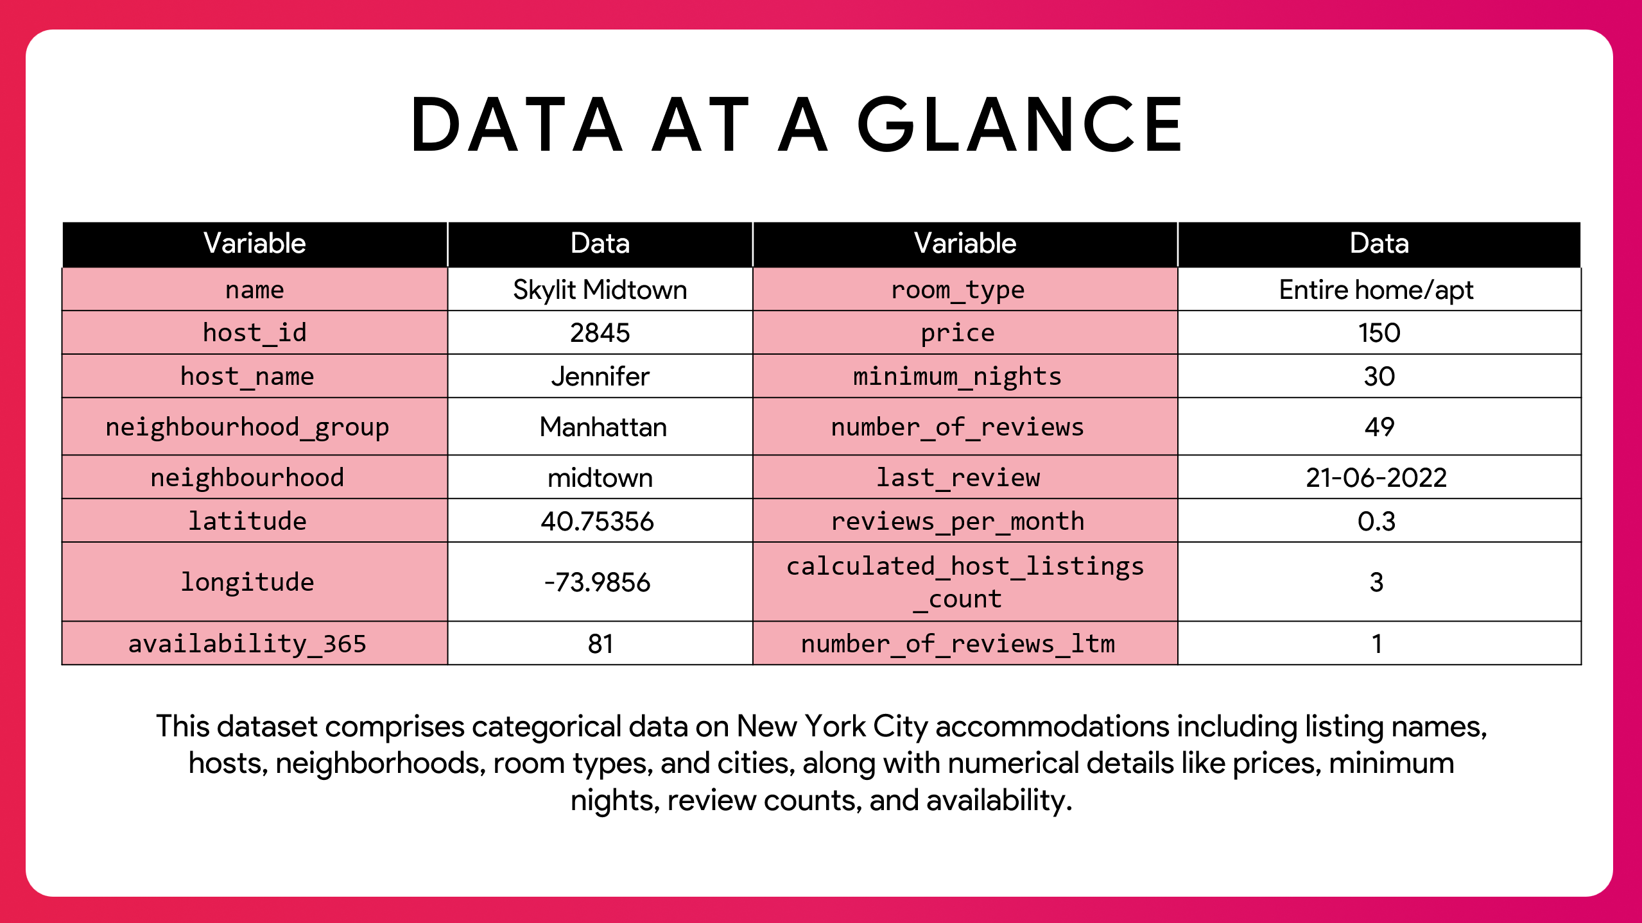

Slide 7

AN OVERVIEW OF AIRBNB LISTINGS IN NYC

Slide 8
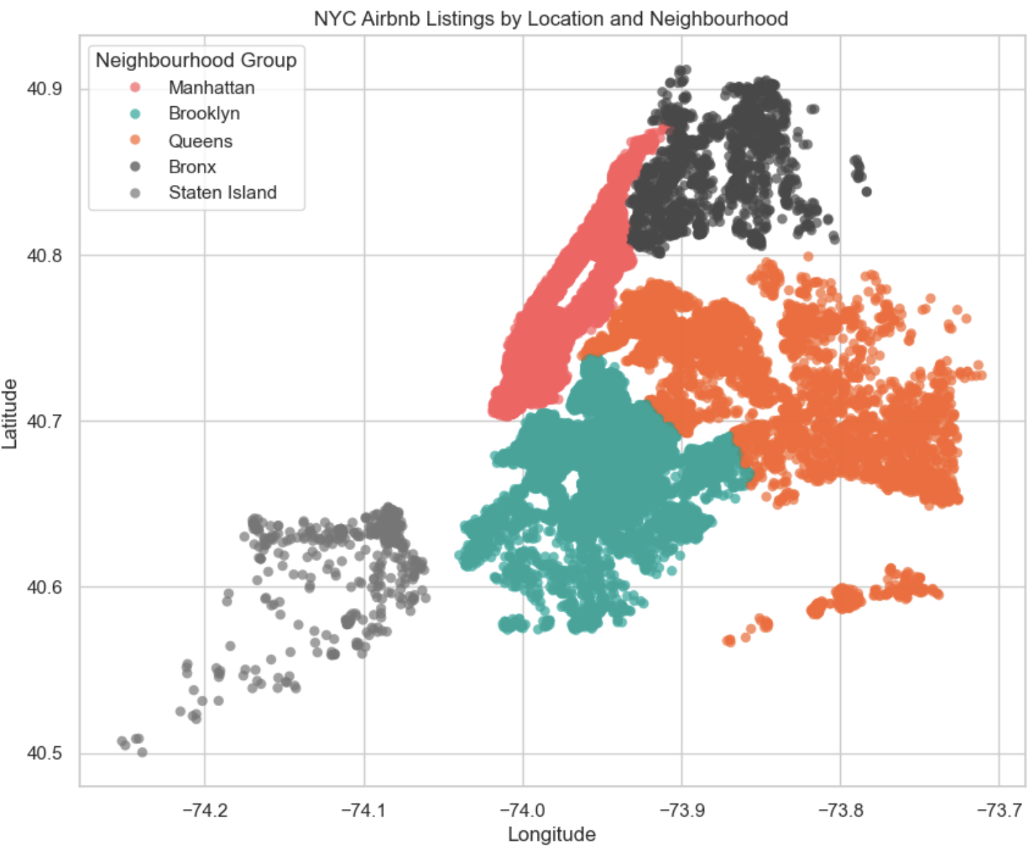
MANHATTAN AND BROOKLYN STAND OUT AS THE MOST DENSELY POPULATED AREAS, HOSTING OVER 80% AIRBNBS

Slide 9
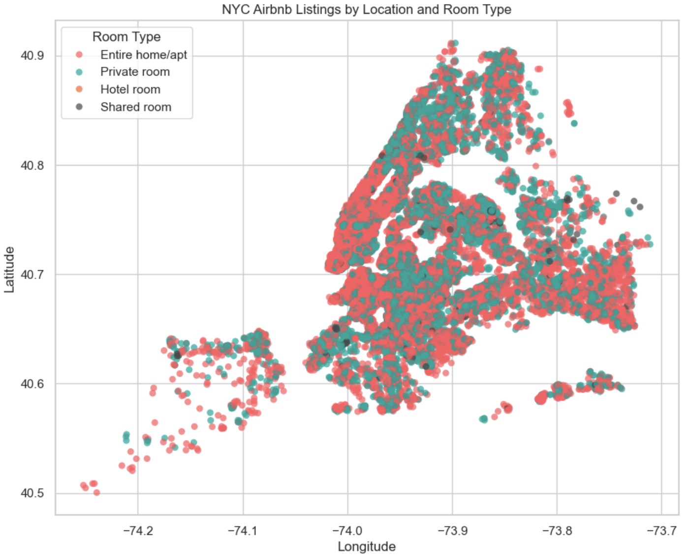
57% LISTINGS ARE ENTIRE HOMES/ APARTMENTS, REFLECTING A STRONG PREFERENCE FOR BOOKING ENTIRE PROPERTY

Slide 10
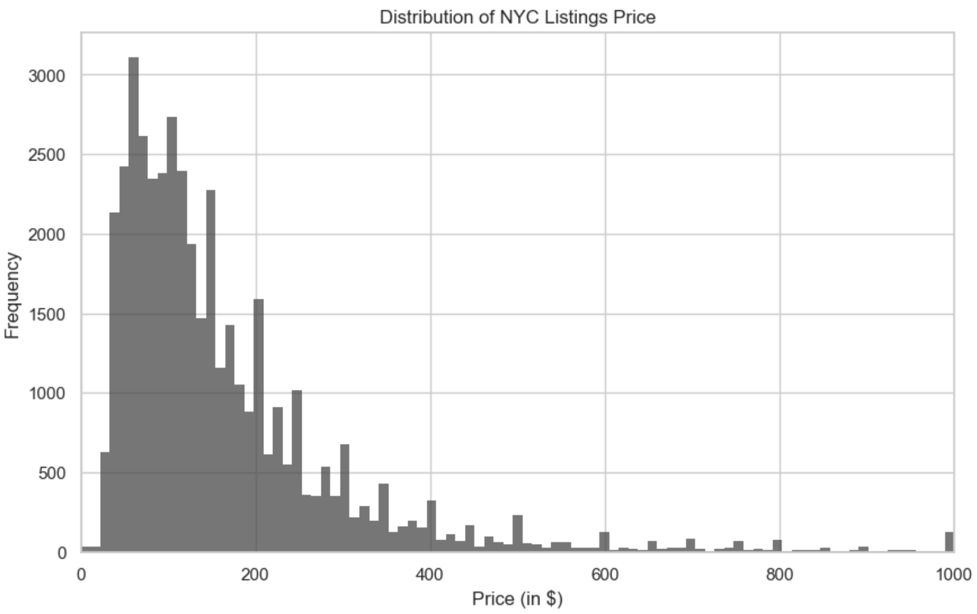
~50% OF THE NYC AIRBNBS
ARE PRICED BETWEEN $30 AND $125

Slide 11
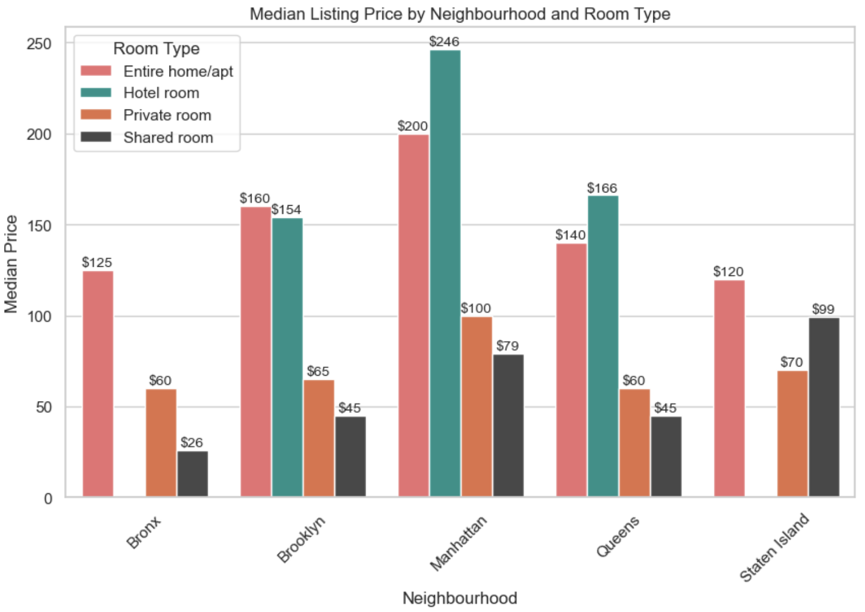
MANHATTAN FEATURES THE HIGHEST PRICE FOR ENTIRE HOMES, INDICATING A DEMAND FOR SPACIOUS ACCOMMODATIONS

Slide 12
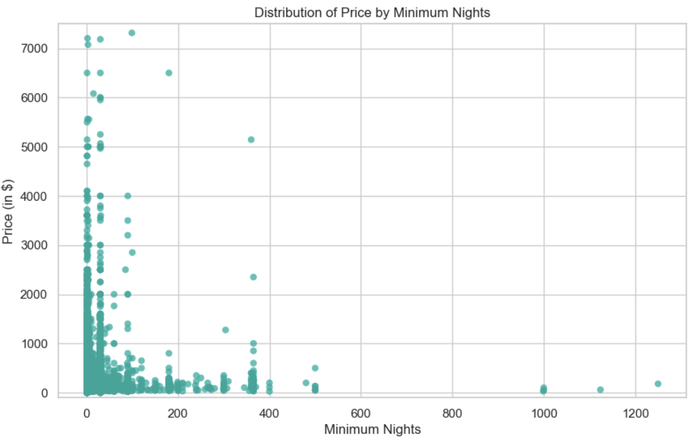
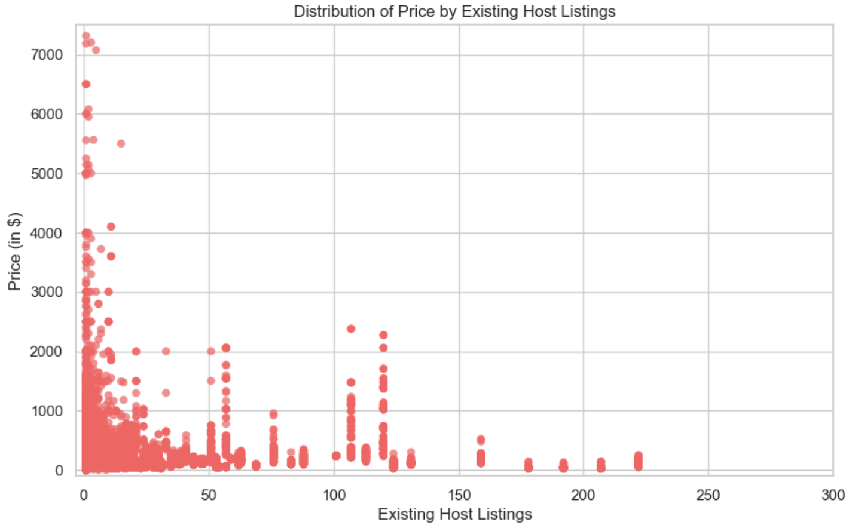
PRICE TYPICALLY DISPLAYS AN INVERSE RELATIONSHIP WITH MINIMUM NIGHTS AND NUMBER OF EXISTING HOST LISTINGS

Slide 13
OPTIMIZING DATA QUALITY AND
FEATURE REPRESENTATION
NUMERICAL VARIABLES
CATEGORICAL VARIABLES
Eliminating outliers: Implemented outlier removal by filtering out data points above the 99th percentile.
This ensures the robustness of the clustering by mitigating the influence of extreme values.
Enhancing representation: Transformed categorical variables into dummy variables via one hot encoding.
This enables the model to include categorical variables also.

Slide 14
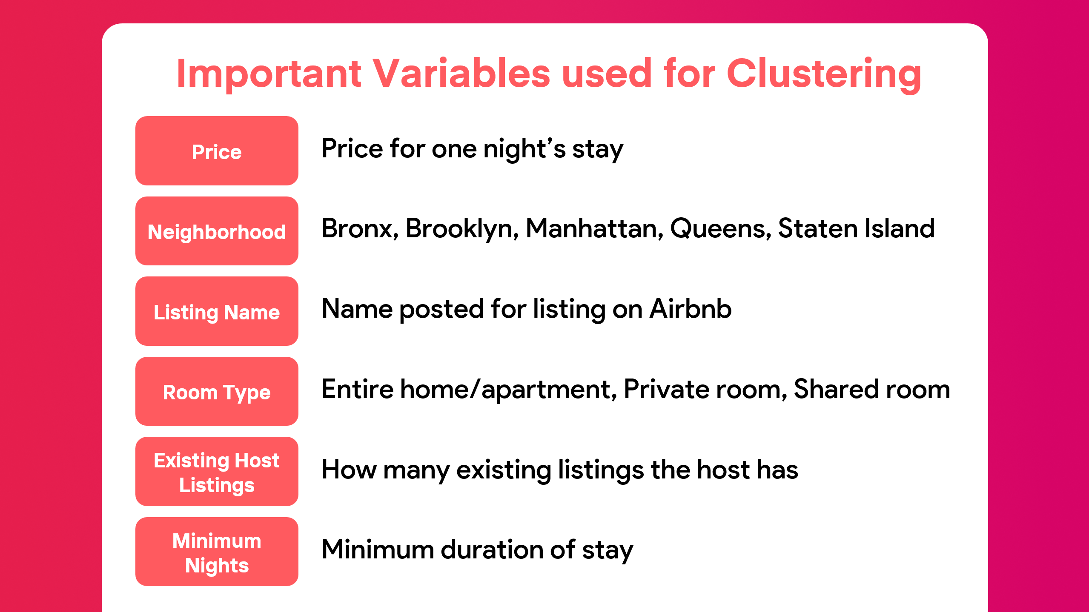

Slide 15
UNDERSTANDING THE MACHINE LEARNING PIPELINE: FROM FEATURE SELECTION TO MODEL COMPARISON
Feature Engineering
Standardize Data
Standard Scaler
Categorical to dummies
Dimensionality Reduction
Principal Component Analysis
ML Modelling
Clustering and Regression
Feature Selection
EDA
Model Comparison
Compare Evaluation Metrics

Slide 16
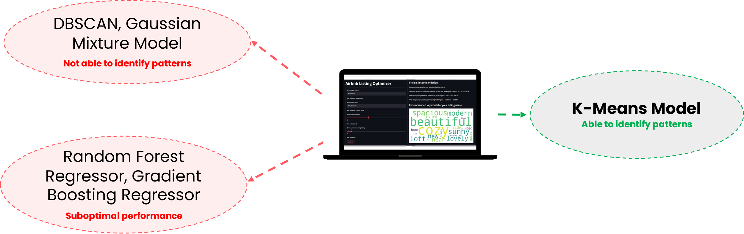
NAVIGATING UNSUPERVISED AND SUPERVISED LEARNING FOR LISTING PRICE PREDICTION
CHALLENGES
Unsupervised Learning - DBSCAN: Clusters most of the listings as outliers. GMM: Overlapping clusters hinder a clear understanding of distinct patterns.
Supervised Learning – Random Forest Regressor and Gradient Boosting Regressor: Suboptimal performance with low R-squared and high RMSE metrics.

Slide 17
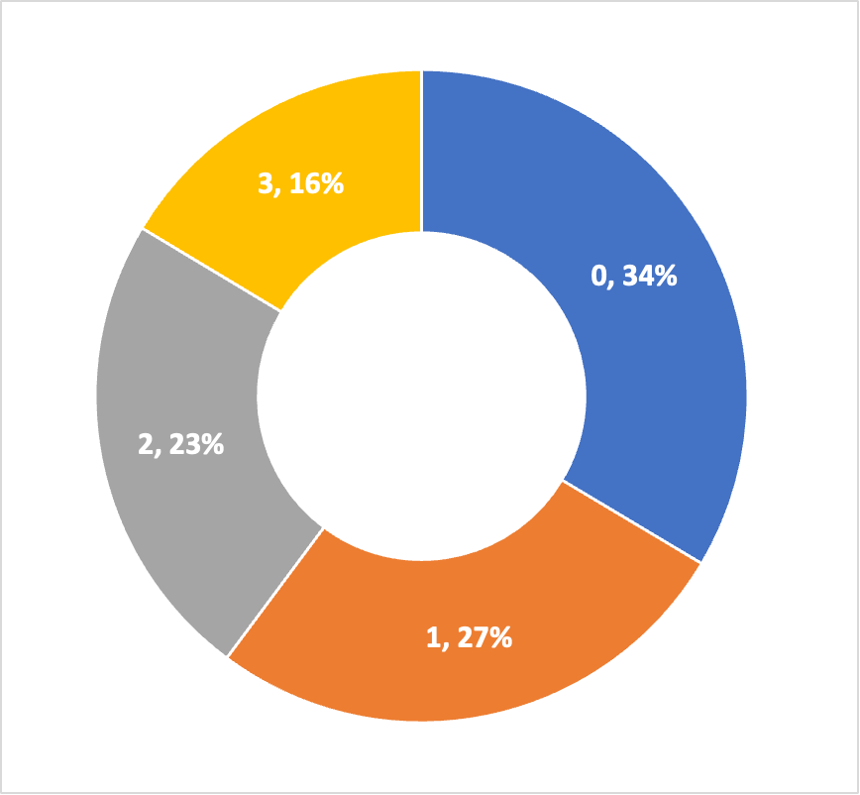
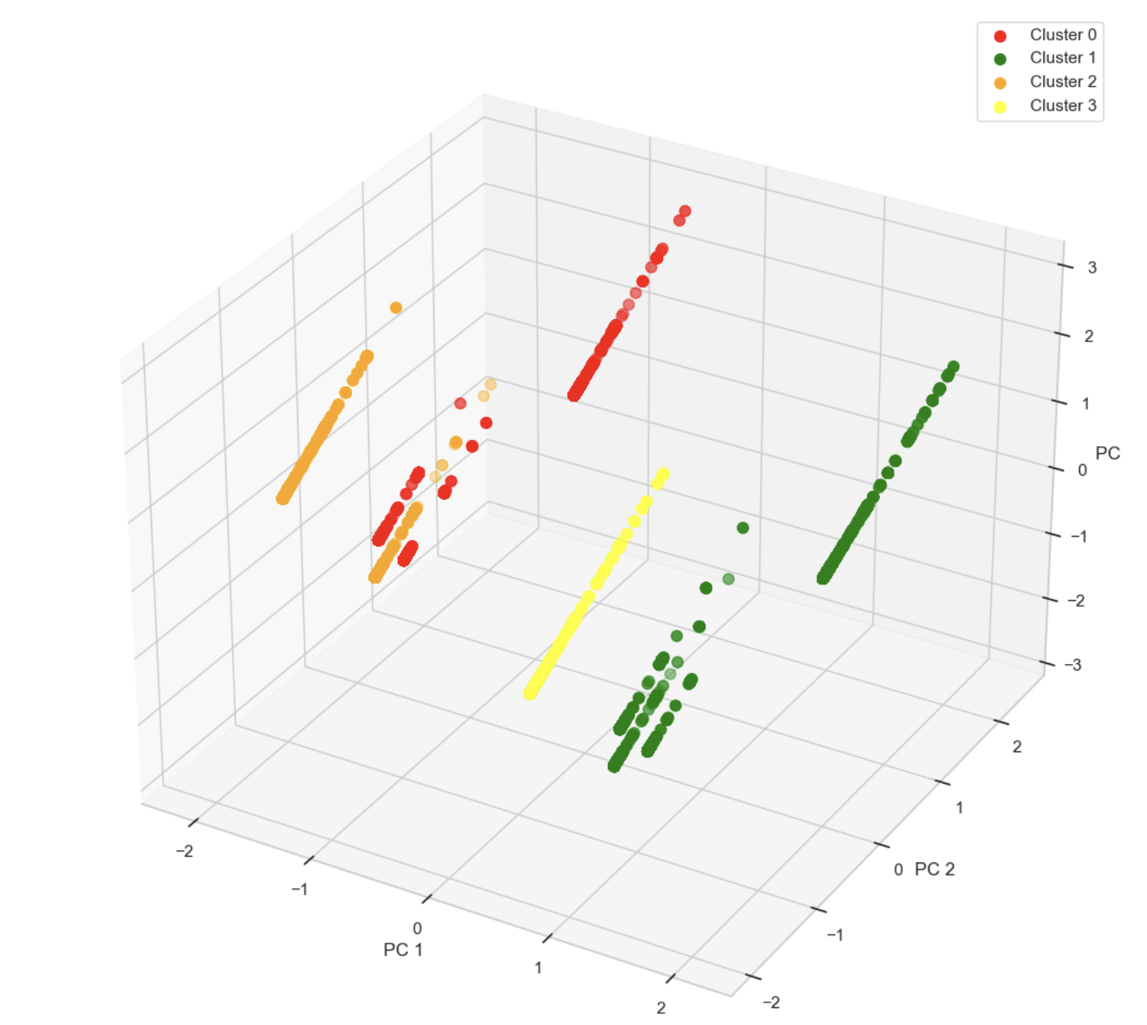
UNLOCKING INSIGHTS WITH K-MEANS:
A CLOSER LOOK AT LISTING PRICES
DISTRIBUTION OF LISTINGS
Cluster | Number of Listings | Median Price | Average Price | Price Segment
0 | ~ 14 K | $ 90 | $ 116 | Medium
1 | ~ 11 K | $ 199 | $ 251 | Very High
2 | ~ 9.7 K | $ 76 | $ 110 | Low
3 | ~ 6.8 K | $ 155 | $ 192 | High
Silhouette score: 0.5 - Identifies how similar an object is to its own
cluster (cohesion) compared to other clusters (separation).
Notes:
Out of ideas to structure this slide!!

Slide 18
PRICING RECOMMENDATION FOR NEW LISTINGS
Extending Insights to New Listings
Cluster Assignment
Suggest Price Range
Model can adapt to diverse input listing data
Utilized pre-trained K-means model input data
Take listing information as input from host
Assigned new listings to established clusters
Get median price of assigned cluster
Suggest price range for new listing +- 12.5% of the median price

Slide 19
PRICING RECOMMENDATION CALCULATIONS
Recommending a range of price to be set depending on the Neighborhood, Room type, Minimum number of nights and existing host listings.
A price range of ± 12.5% is recommended to include buffer for providing discount and breaking into the competitive market.
Host pays a flat 3% (incl cleaning fee) service fee to Airbnb per booking.
Customers pay a 14% service fee to Airbnb per booking.

Slide 20
KEYWORD RECOMMENDATION FOR LISTING NAME
User Input
Input Parameters: Neighborhood, Room Type, Minimum Nights of Stay, Number of Other listings
Technique: Text Mining
Features: Listing Name
Modeling and Solution Delivery:
Clean, pre-process, tokenize and vectorize listing names
Calculate the median reviews for existing listings in assigned cluster
Use the median threshold as a filter to retrieve all listings in the assigned cluster that exceed the threshold
Filters applied: Cluster assigned, Median reviews threshold
Extract frequently used keywords from these listing names
Recommend top 20 popular keywords to host for new listing name
Clustering Model
Assigned Cluster Labels
Text Mining
Top 20 Keywords Suggestion
Output Results: Suggested Keywords
Notes:
Clean, pre-process, tokenize and vectorize listing names
Calculate the median reviews for existing listings in assigned cluster
Use the median threshold as a filter to retrieve all listings in the assigned cluster that exceed the threshold
Filters applied: Cluster assigned, Median reviews threshold
Extract frequently used keywords from these listing names
Recommend top 20 popular keywords to host for new listing name

Slide 21

Sample Results

Slide 22
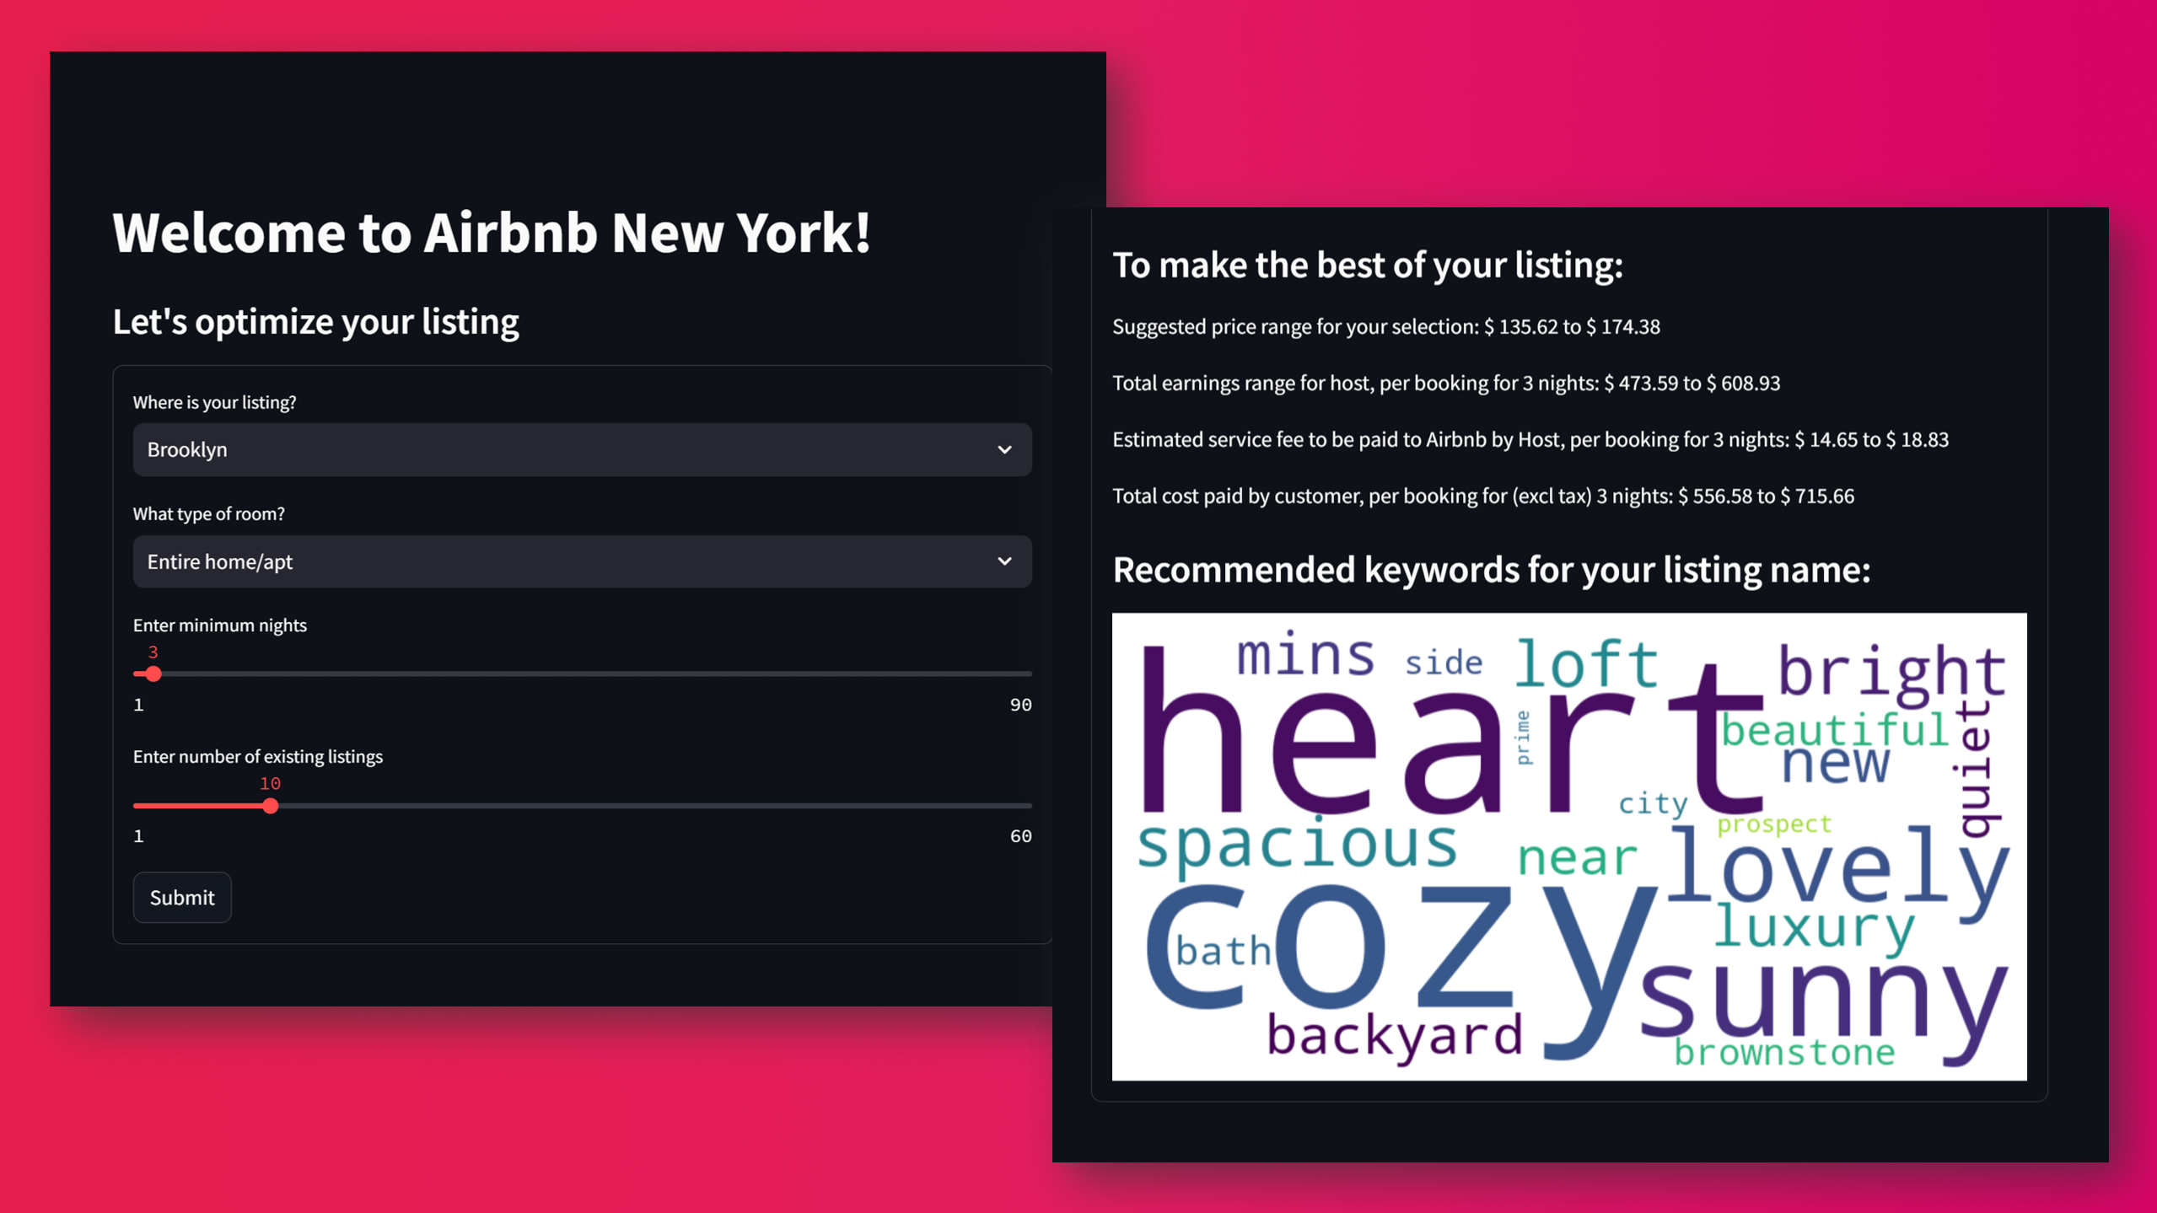
Open Application

Slide 23



FUTURE SCOPE
Expand the existing model to multiple cities
Currently the model has been built only for NYC Airbnb listings
Gather more data/features to improve the model
These can be the number of bathrooms, sqft area, amenities, type of property, distance from key places like airport
Model improvement
Feature addition and engineering according to the evolving market dynamics
Notes:
refine

Slide 24
REFERENCES
https://www.searchlogistics.com/learn/statistics/airbnb-statistics/
https://www.businessofapps.com/data/airbnb-statistics/
https://rabbu.com/airbnb-data/new-york-ny
https://www.statista.com/statistics/1265037/new-york-monthly-airbnb-listings/
https://ipropertymanagement.com/research/airbnb-statistics?u=%2Fresearch%2Fairbnb-statistics#host
https://www.stratosjets.com/blog/airbnb-statistics/
https://fourweekmba.com/airbnb-pricing-strategy

Slide 25
APPENDIX

Slide 26
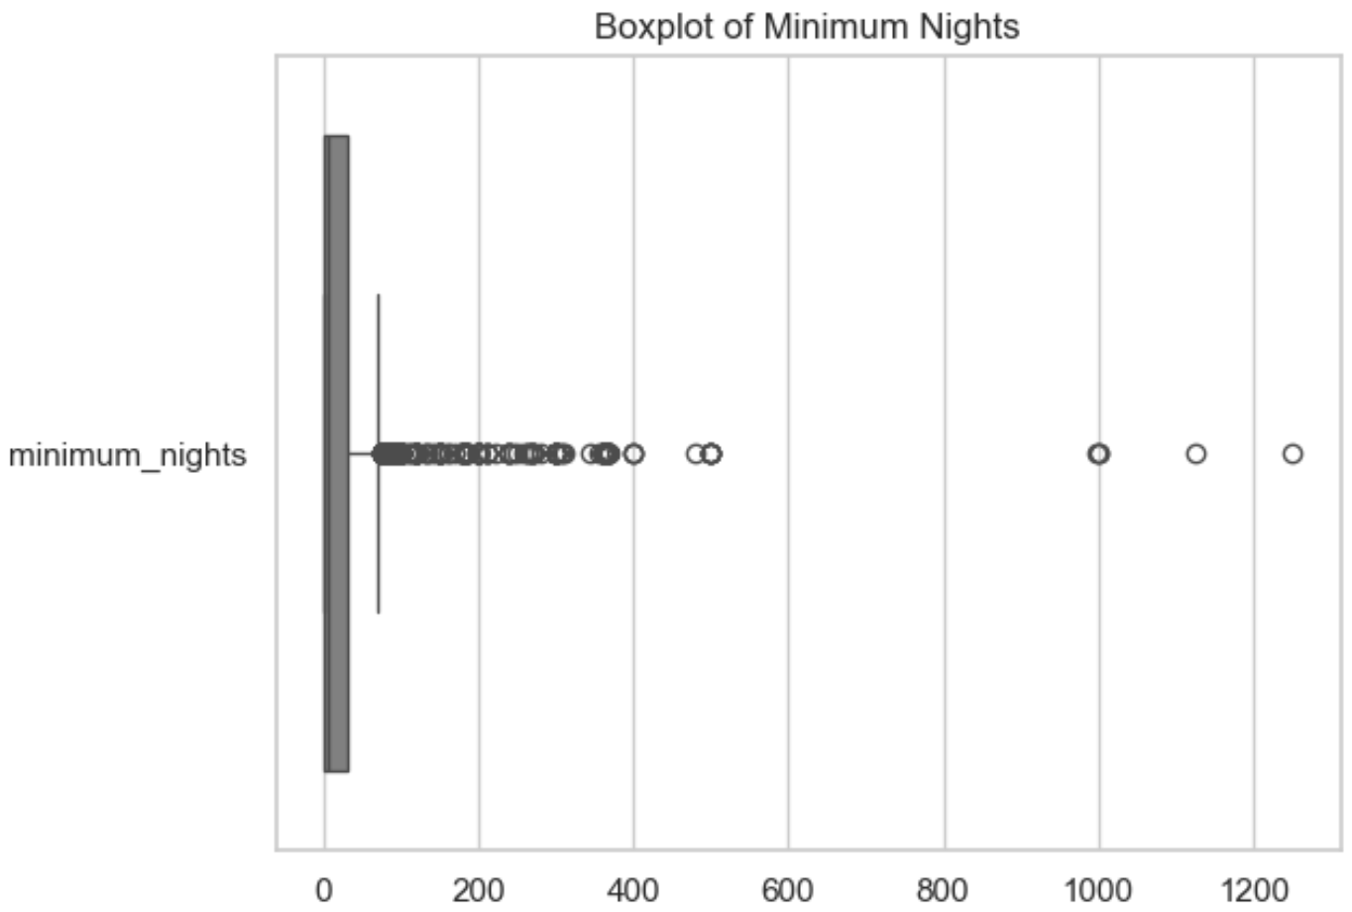
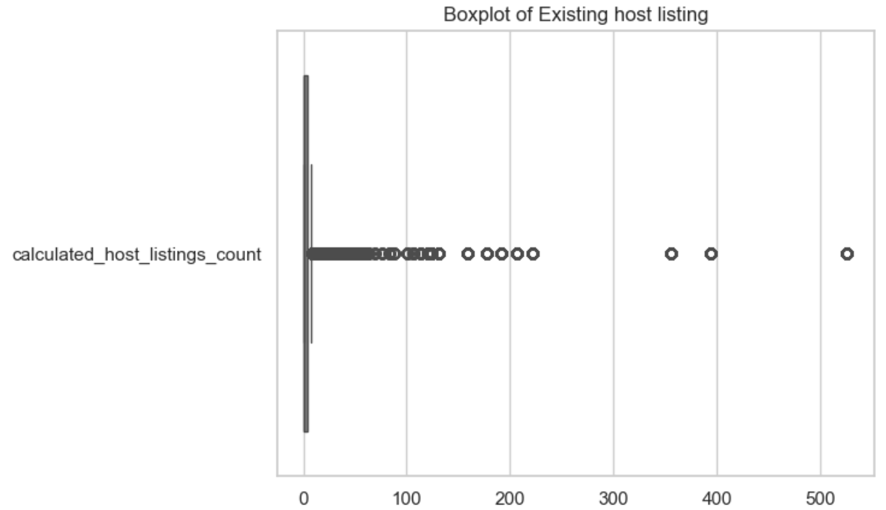
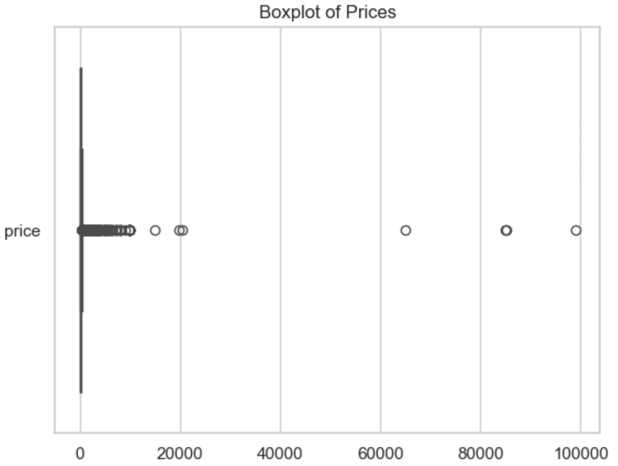
OUTLIER DETECTION AND REMOVAL Filtered out data points above the 99th percentile.

Slide 27
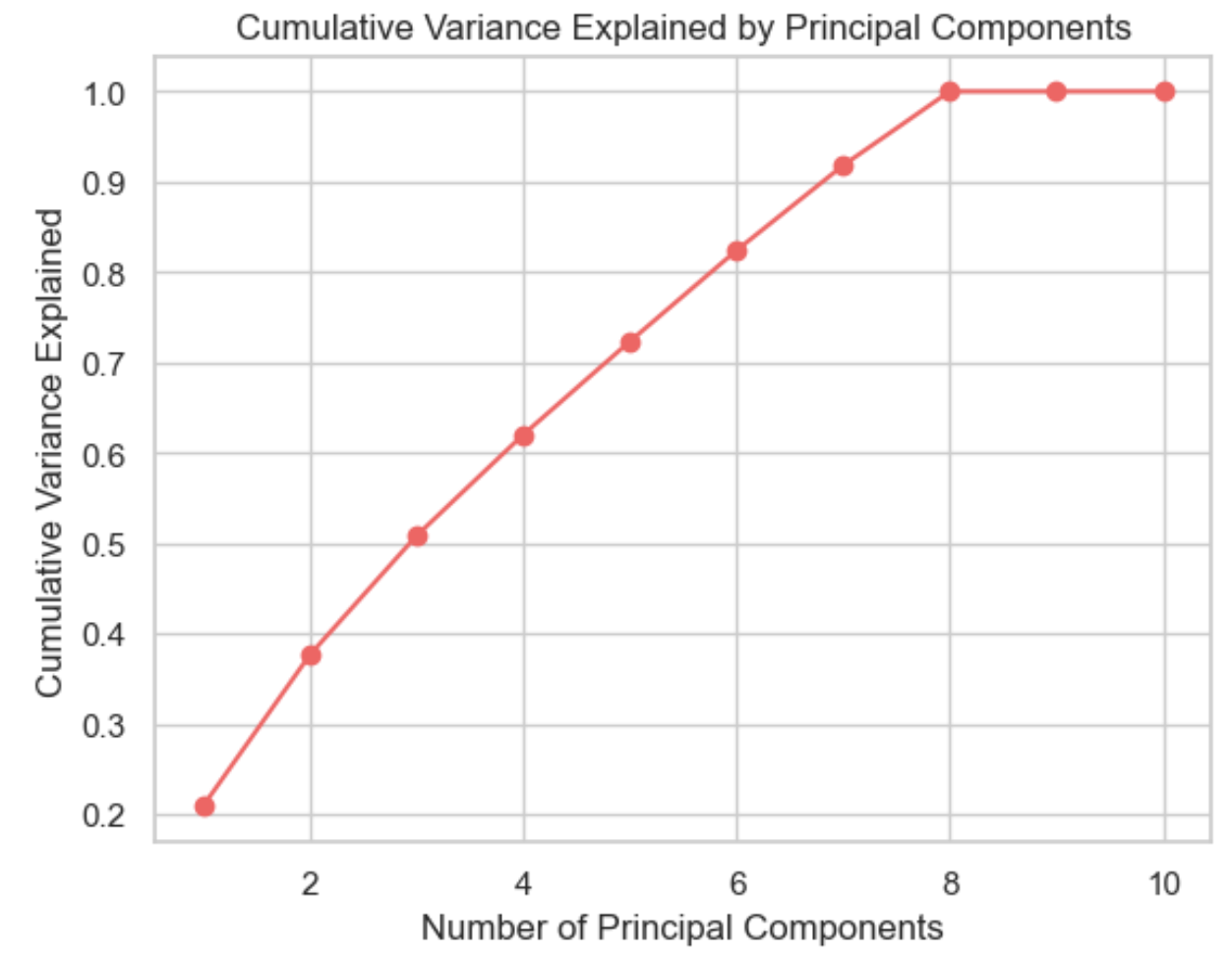
DIMENSIONALITY REDUCTION USING PCA
First 6 principal components explain more than 80% variation in the data.
Selected data for first 6 PCs.

Slide 28
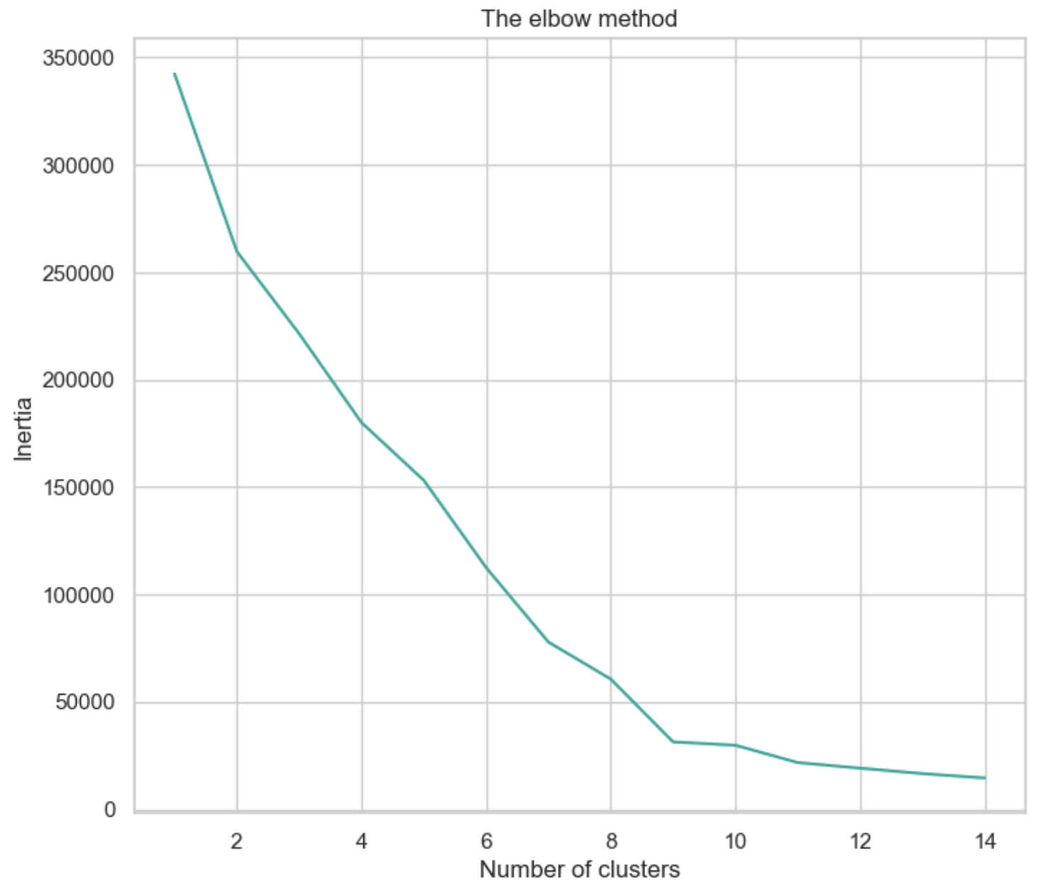
SELECTION OF ‘K’ FOR K-MEANS
Inertia plot shows an elbow at range of 8 to 9 which indicates a value for K.
However, the clusters are overlapping at this high value of K.
Reduced K by comparing silhouette score for different values of K.
Chose the K that maximizes the silhouette score while avoiding overlapping clusters.

Slide 29
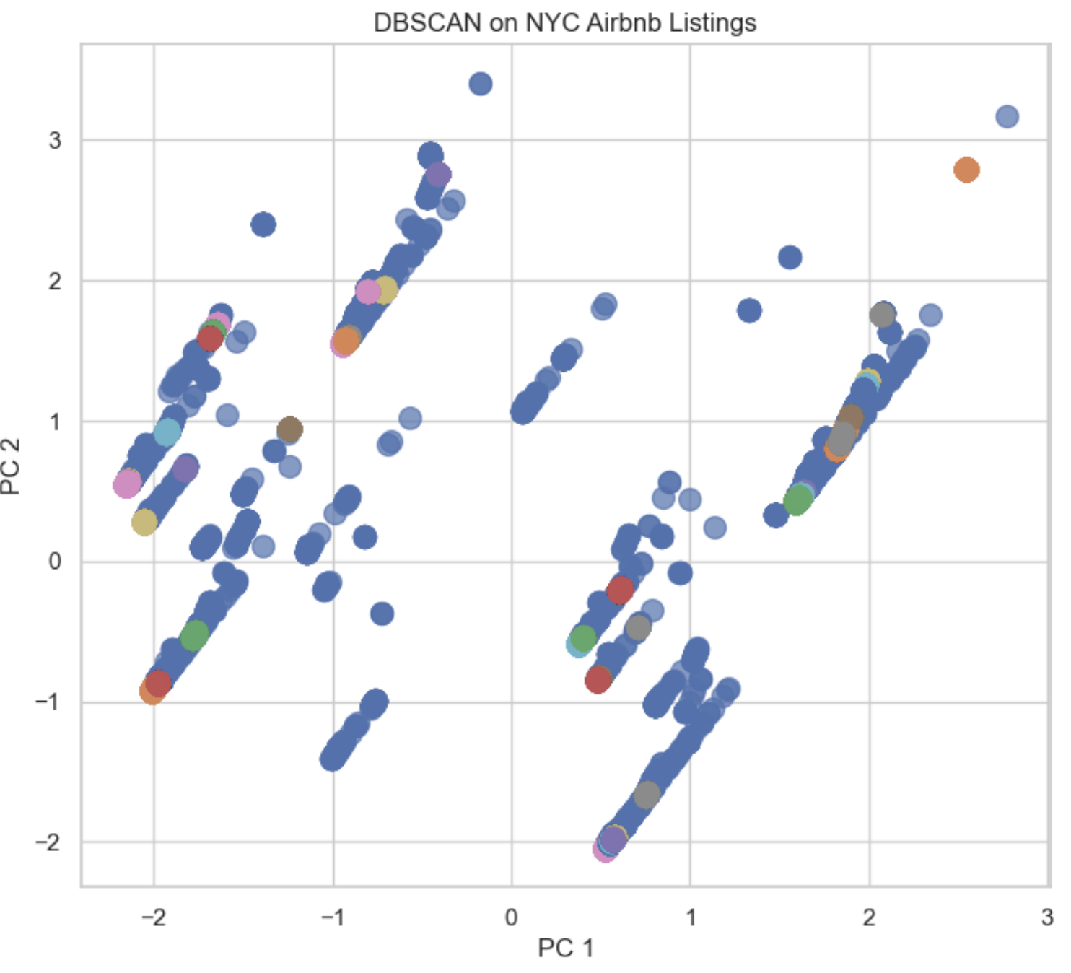
DBSCAN RESULTS
DRAWBACKS:
Model fails to identify the similarities between listings.
Clusters most of the listings as outliers.

Slide 30
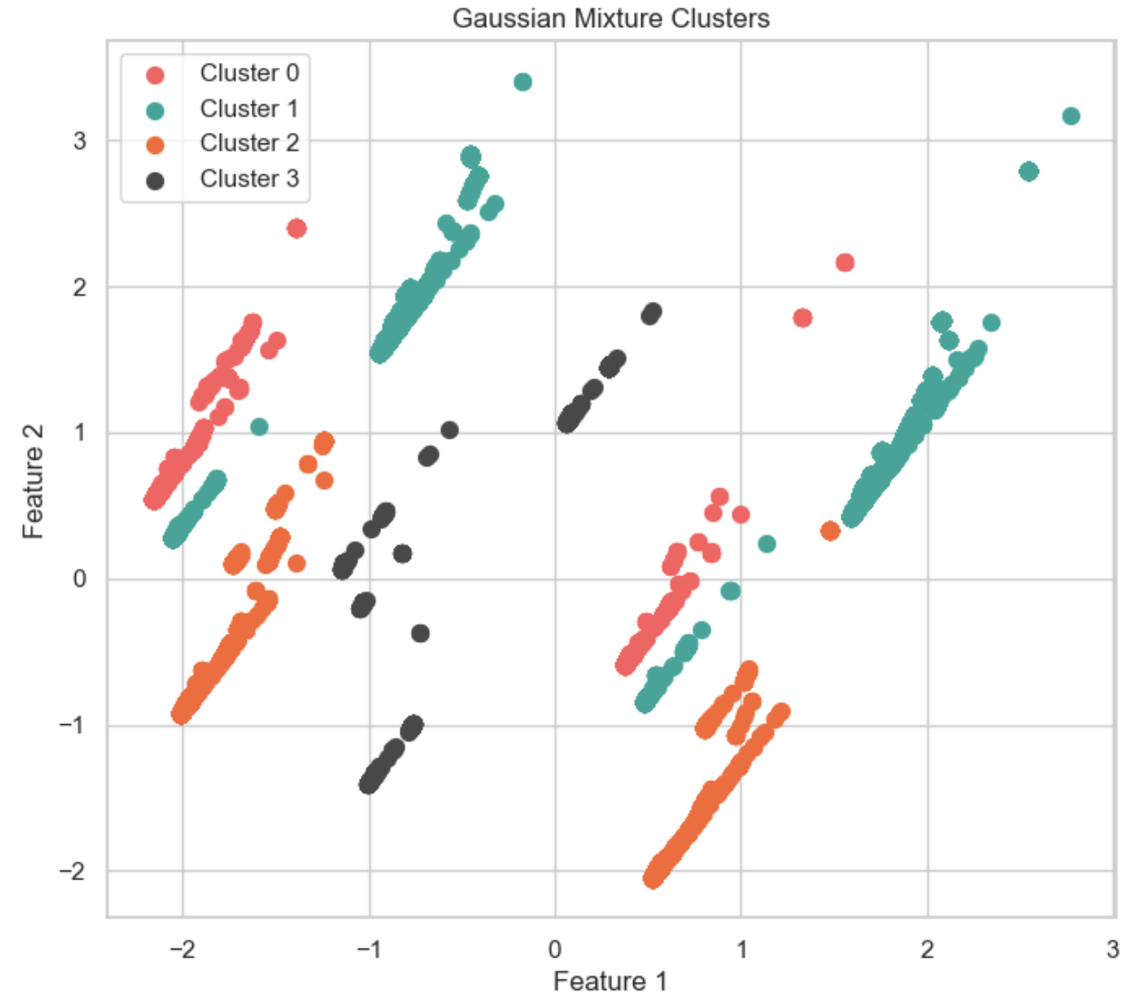
GMM RESULTS
DRAWBACKS:
There is an overlap among clusters.
Lower Silhouette Score than K-Means.

Slide 31
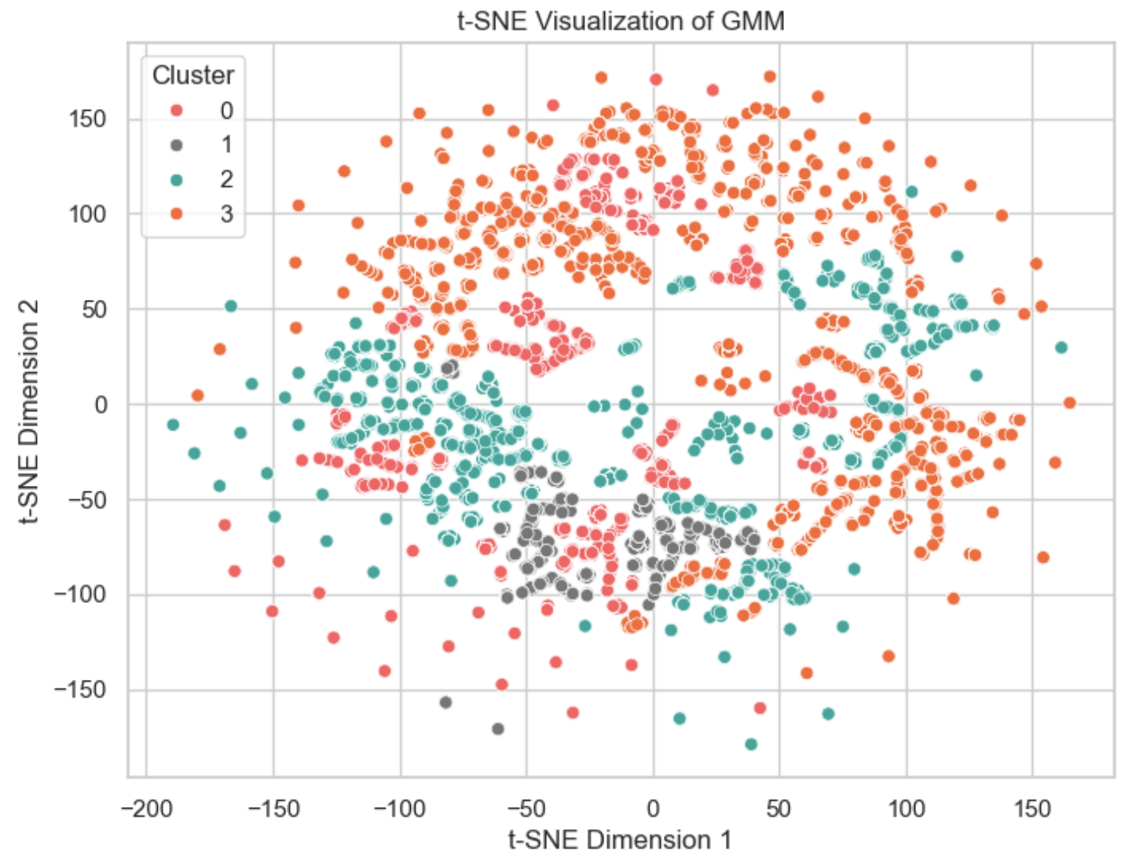
GMM RESULTS – t-SNE VISUALIZATION
DRAWBACKS:
There is an overlap among clusters.

Slide 32
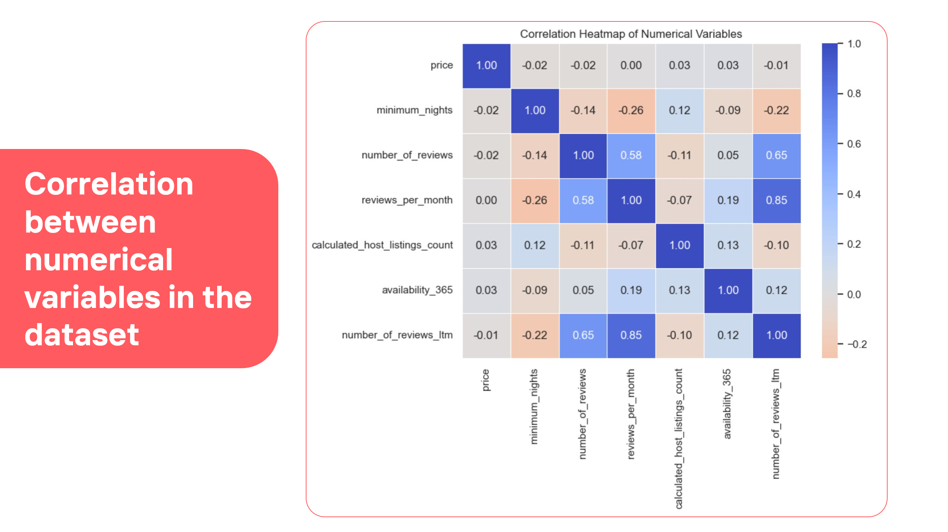

Slide 33
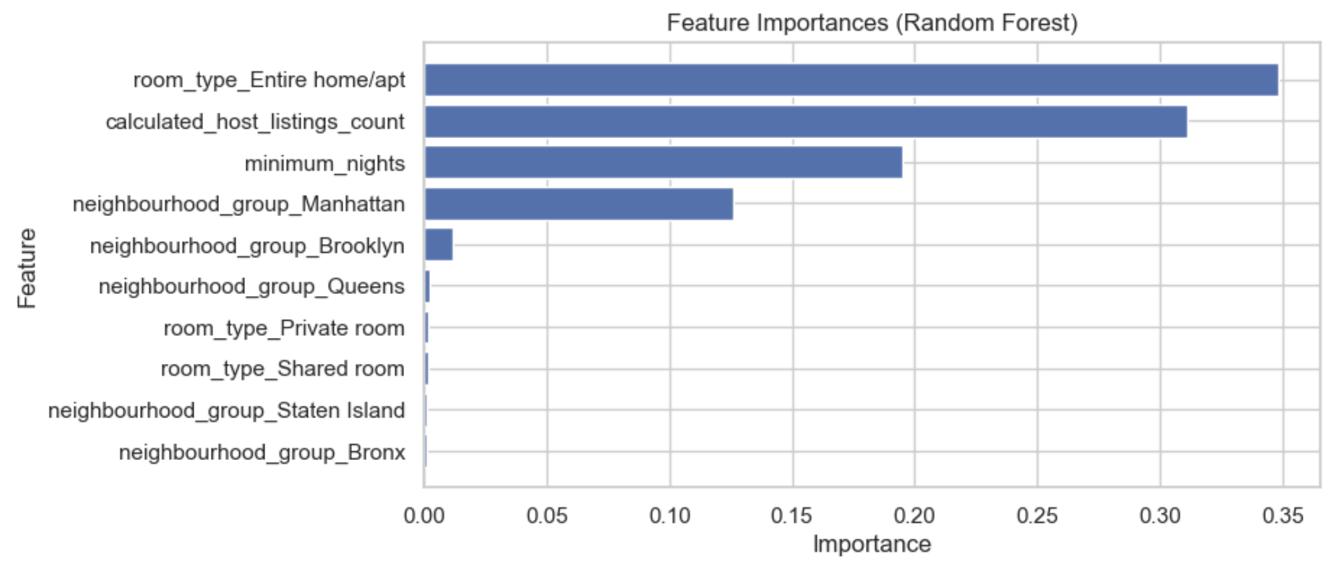
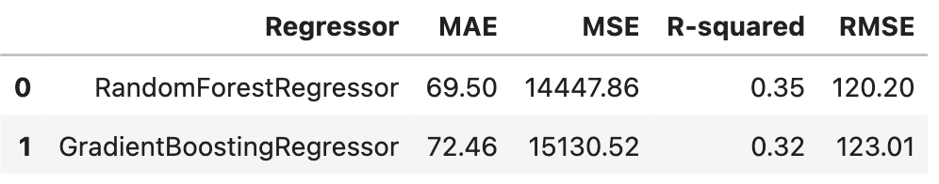
REGRESSION RESULTS
DRAWBACKS:
Models fail to explain the variation in price with low R squared and high RMSE.
Given the suboptimal performance of the regression models, exploring alternative approaches like clustering for predicting listing prices seems reasonable.
RANDOM FOREST
FEATURE IMPORTANCE

